Slide 1
NCR No: 11749
QER: JULIMAR DEVELOPMENT PHASE 3 SF301229C002.05+06+07 (ST203.72124) - Zeta Wire Damaged

Slide 2
Pipe Section Details
Item | Traceability / Identification
Project Number | 301229C002
Project Name | JULIMAR DEVELOPMENT PHASE 3
Pipe Section | SF301229C002.03
Structure number | ST203.72124
Affected Layer | Zeta Pressure Vault
Length Affected | 768.2m
Drawing Number / MP Code / STA | ZETA 6.2 FI09 (MP205)

Slide 3
Overview of Anomaly
Problem Description:
During the zeta spiraling of JULIMAR DEVELOPMENT PHASE 3 SF301229C002.03 (ST203.72124), zeta wire damage was detected after accumulator at length 768.2m.
Root Cause:
  The root cause was identified due to zeta wire offset/dislocated from roller accumulator and lead the wire damaged. The wire was dislocated due to gap for adjustment roller is too big (Original Design).
Immediate Action Taken:
  Production performed un-spiralling, removed affected wires and re-weld before proceeding spiralling process. Dimension after repaired are all within criteria and accepted as per DP-QCP-08DAQT001.

Slide 4
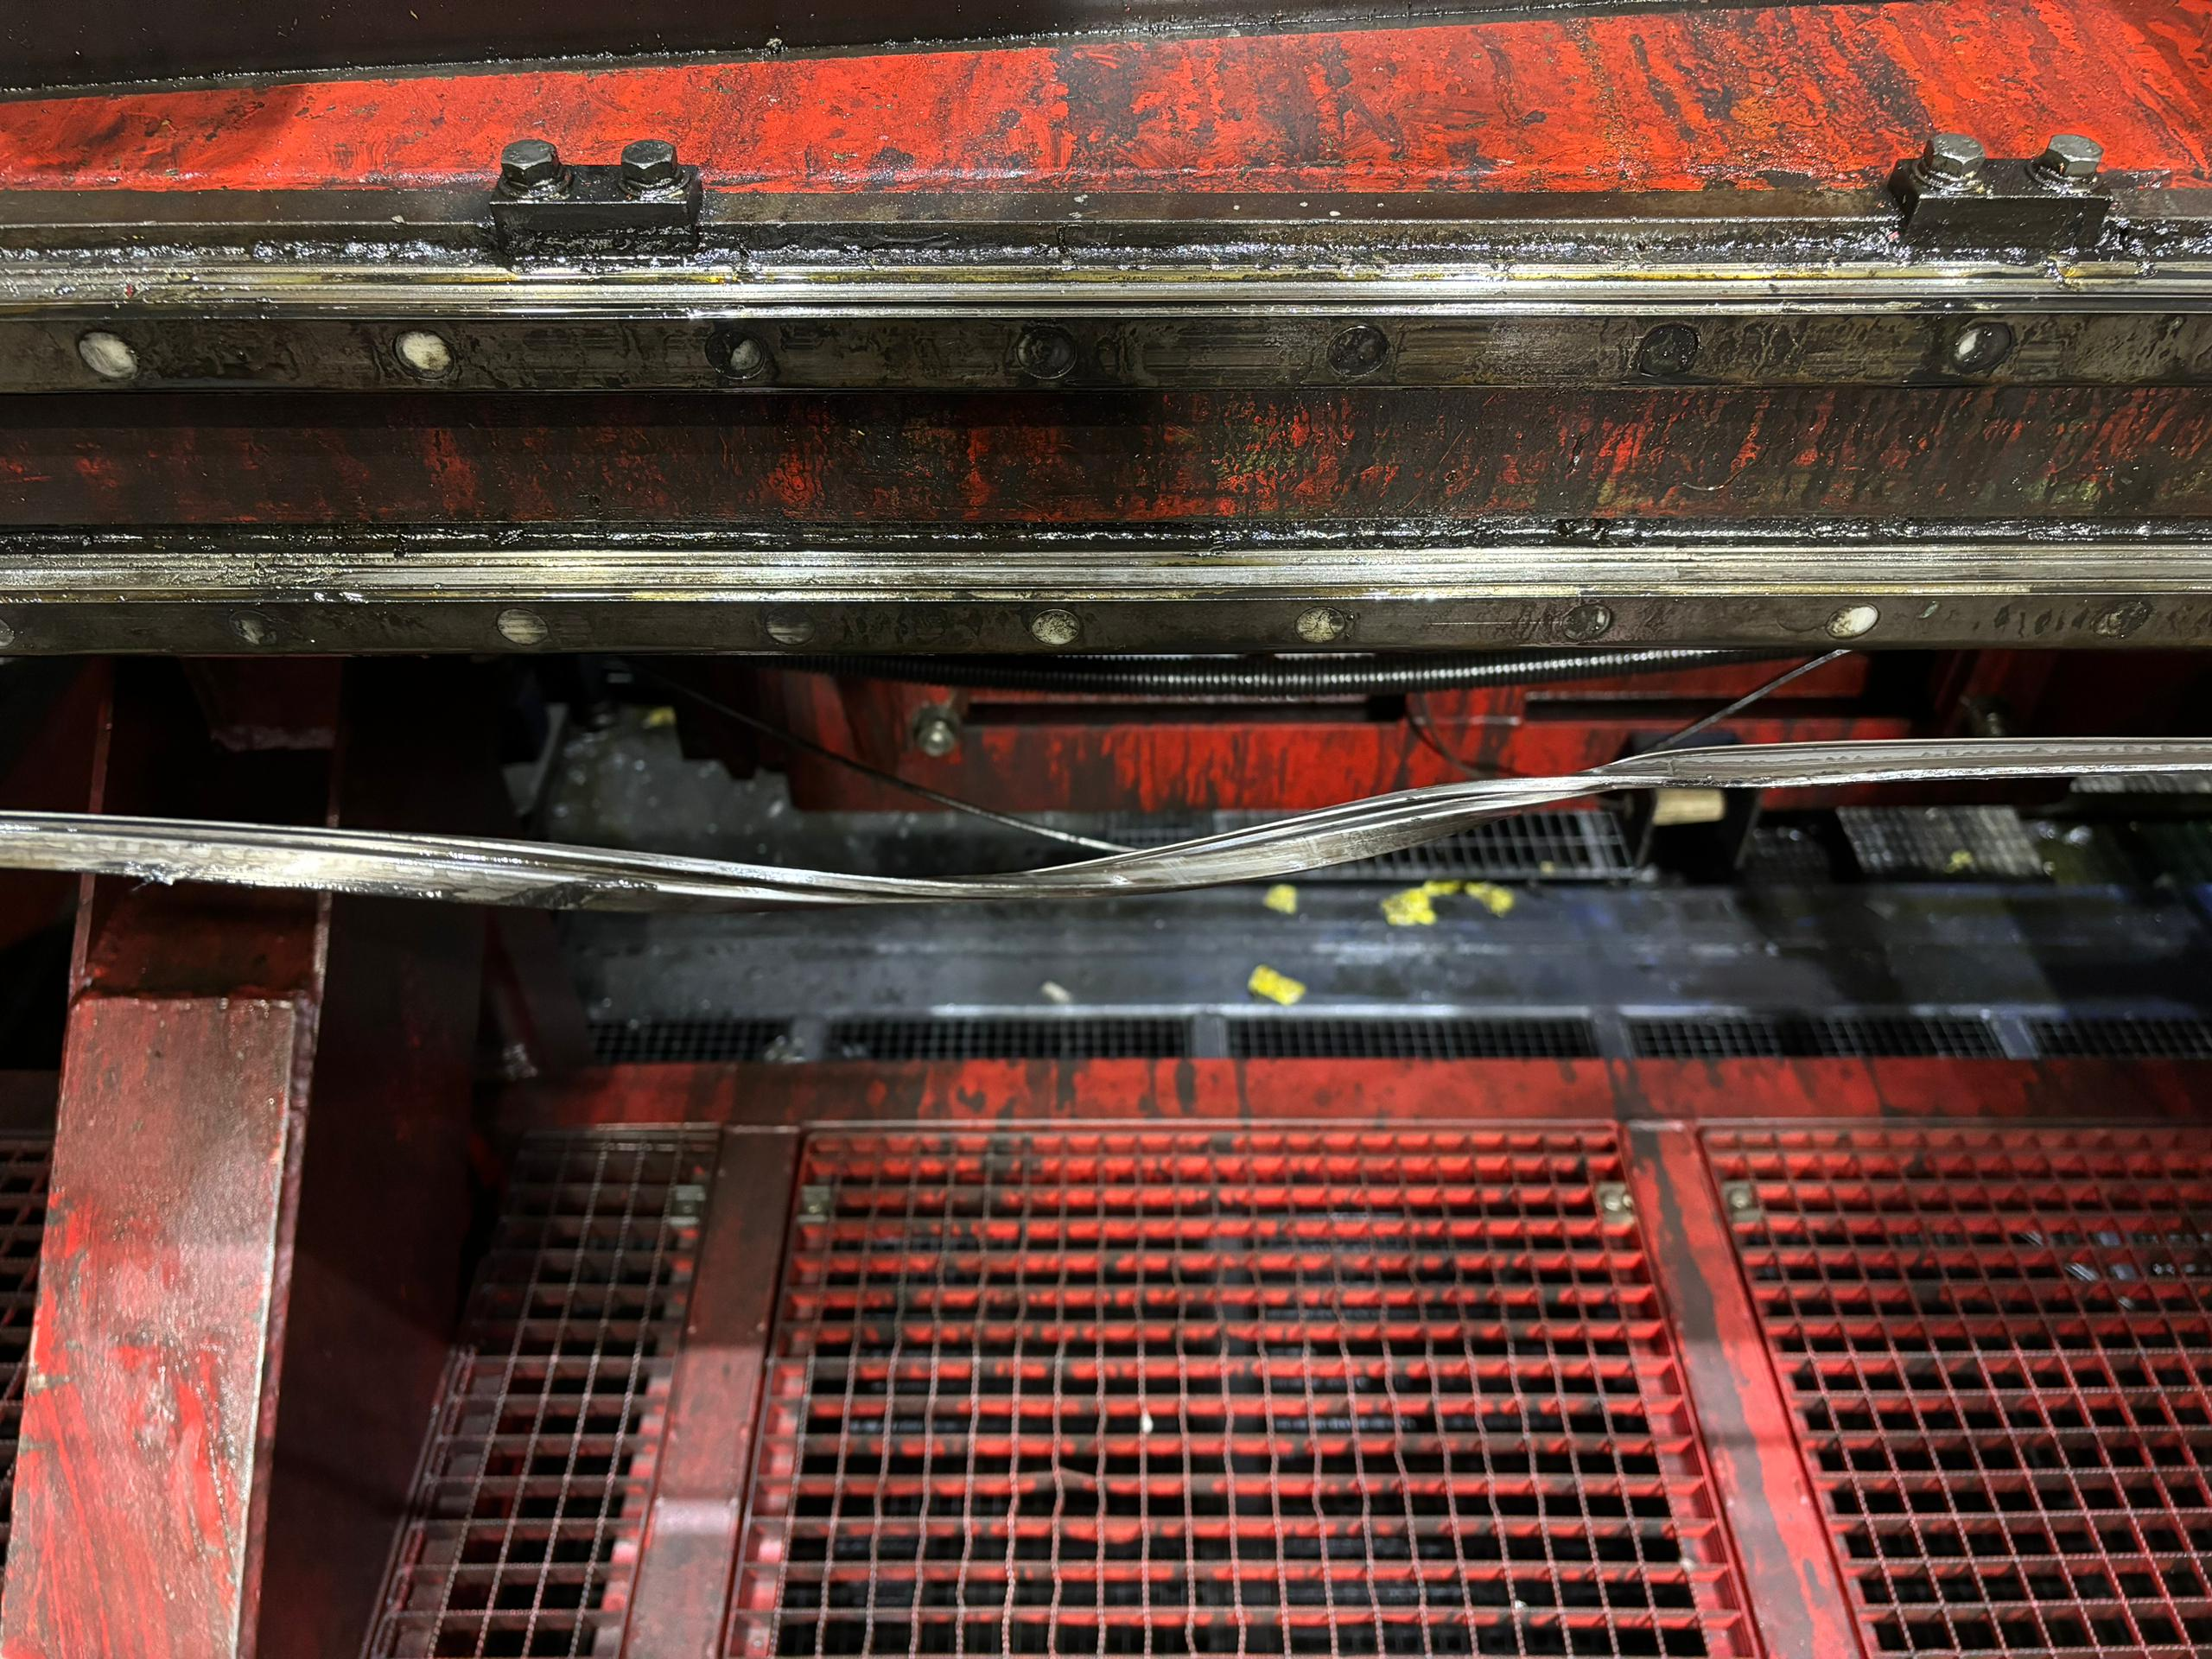
Defect Photos
Figure 1 : Zeta wire damage was detected after accumulator at length 768.2m.

Slide 5
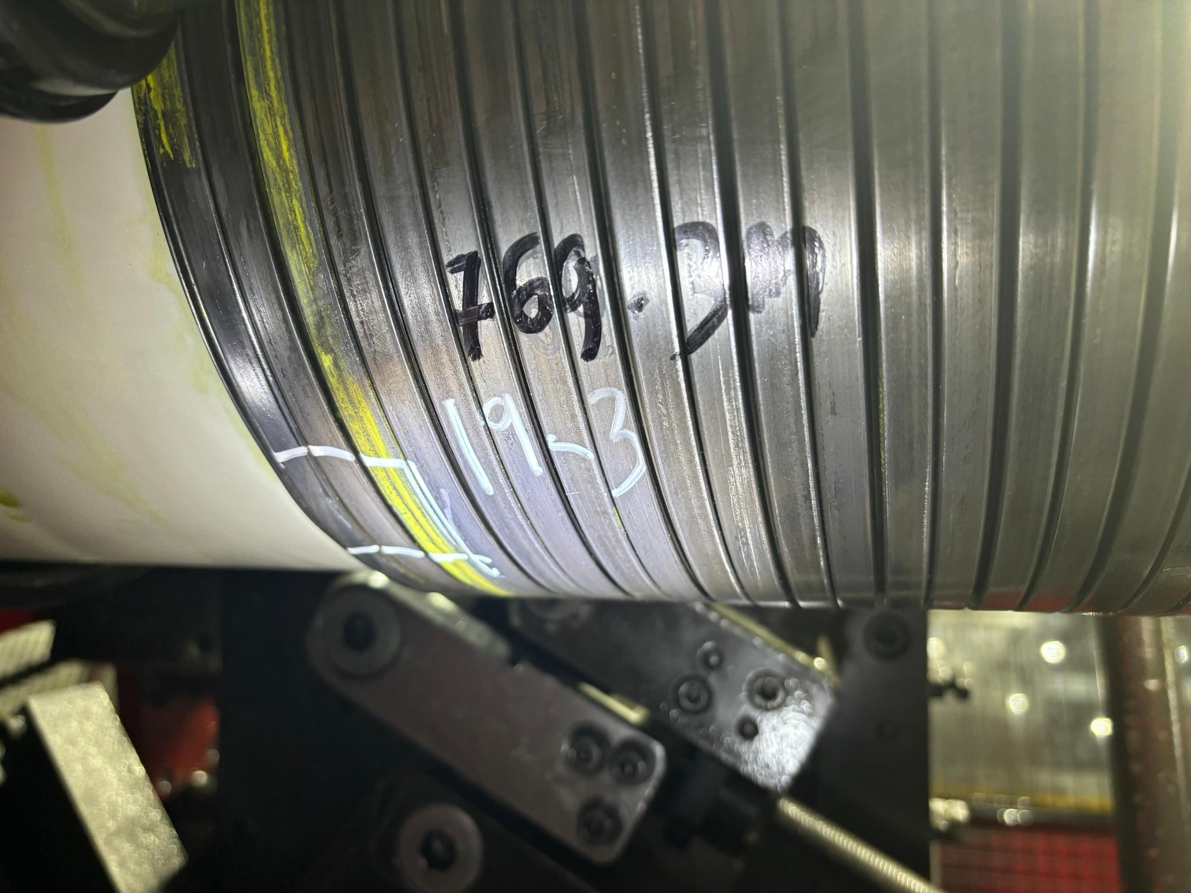
Repair Photos
Adjustment shaft
Wire dislocate through the gap
Figure 2 : Production performed un-spiralling, removed affected wires and re-weld before proceeding spiralling process.

